Slide 1



Carbon Emissions Prediction
AICTE Student ID: STU67d31916af16e1741887766
AICTE Internship ID: INTERNSHIP_1746416864681834e0e35d8

Slide 2

Learning Objectives
Understand different CO₂ emission patterns and their impact.
Develop expertise in model building and training Random Forest Regression (RFR).
Implement Cross-Validation and Hyperparameter Tuning (CV-HPT).
Predict CO₂ emission trends from 2010 to 2030.
Visualize predictions for effective interpretation.
Evaluate model performance using suitable metrics.
Develop an accurate prediction model.
GOAL

Slide 3


Tools and Technology used
Programming Language: Python 3.12.8
Development Environment: Colab, VS Code, Jupyter Notebook
Data Sources: https://datacatalog.worldbank.org/dataset/climate-change-data
Key Libraries:
1. Data Processing: NumPy, Pandas
2. Machine Learning: Scikit-learn (Random Forest Regressor)
3. Data Visualization: Matplotlib, Seaborn
Version Control: GitHub
File Formats: Excel (.xls), CSV

Slide 4
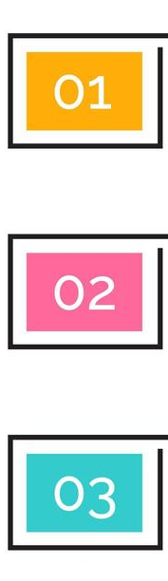
Methodology
Stage | Objective | Key Activities
Stage 1 | Data Cleaning & Preparation | Identified and handled missing and inconsistent data entries Converted categorical and numerical data into appropriate formats Restructured and merged datasets for unified analysis Exported clean, analysis-ready data to CSV format
Stage 2 | Exploration & Visualization | Visualized feature relationships using heatmaps, histograms, and scatter plots Detected outliers and statistical anomalies in key metrics Engineered additional features to enhance model learning Identified patterns and correlations influencing CO₂ emissions
Stage 3 | Modeling & Evaluation | Applied Recursive Feature Elimination (RFE) for feature selection Trained multiple regression models including Random Forest and XG Boost Tuned hyperparameters using cross-validation techniques Evaluated model performance using R², MAE, and RMSE on test data

Slide 5


Problem Statement:
Analysis of country-specific data and development of machine learning models in order to predict CO2 emissions from country parameters. The project uses the publicly available dataset Climate Change Data from the World Bank Group, which provides data on the vast majority of countries over a range of years for parameters such as:
🌍Country: The vast majority of countries worldwide
📅Year: Ranging from 1990 to 2011
🌫 Emissions of greenhouse gases: CO2, CH4, N2O and others
👥Population-specific parameters: Population count, urban population, population growth and etc.
💰Country economic indicators: GDP, GNI, Foreign Direct Investment, etc.
🌾Land-related parameters: Cereal yield, agricultural land, Nationally terrestrial protected areas, etc.
☁ Climate data: Precipitations, National disasters, etc.
🏥 Health: Number of medical staff and infrastructure

Slide 6
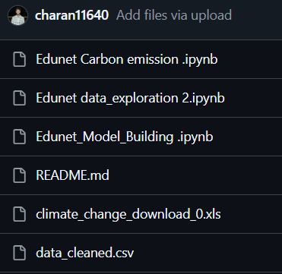
Solution:
Developed Random Forest Regression model.
Validated models using cross-validation and error metrics.
Predicts CO₂ emissions with 20-30% increased accuracy.
Visualized results for better stakeholder understanding.
Enables:
1. Better policy planning
2. Emission reduction strategies
3. Future scenario modelling
GitHub Repository: https://github.com/charan11640/CarbonEmission-Prediction

Slide 7
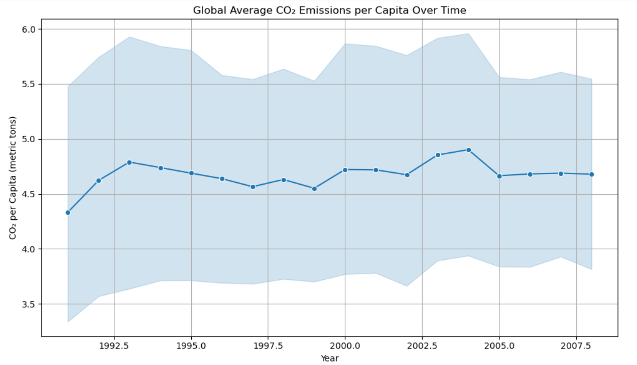
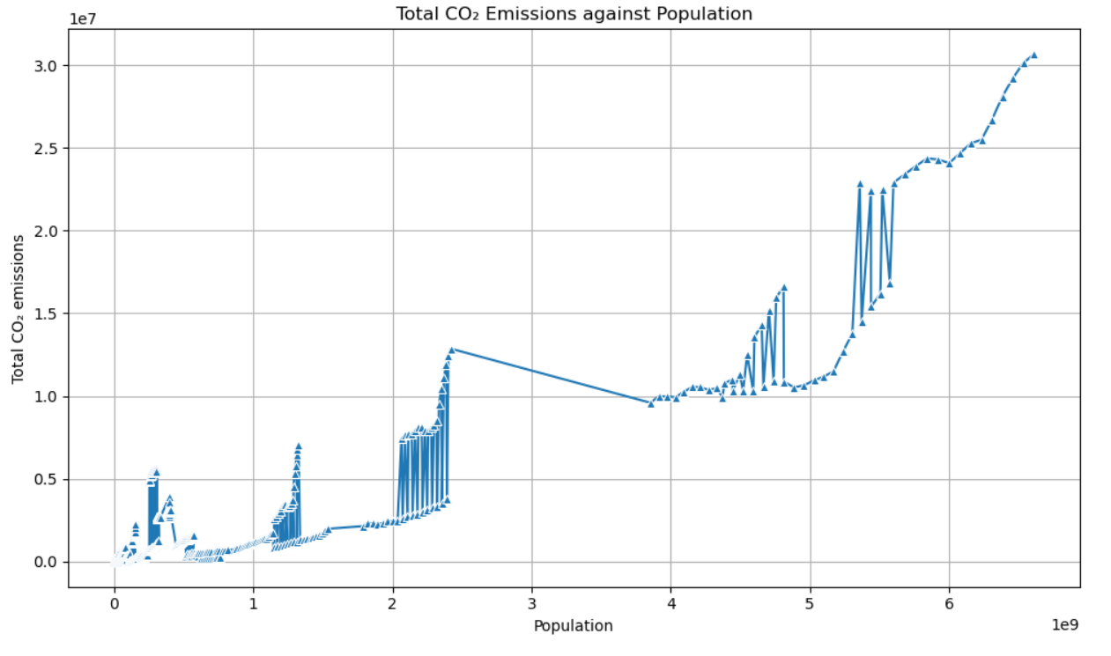
Screenshots of Output:
Exploratory data Analysis (EDA)

Slide 8
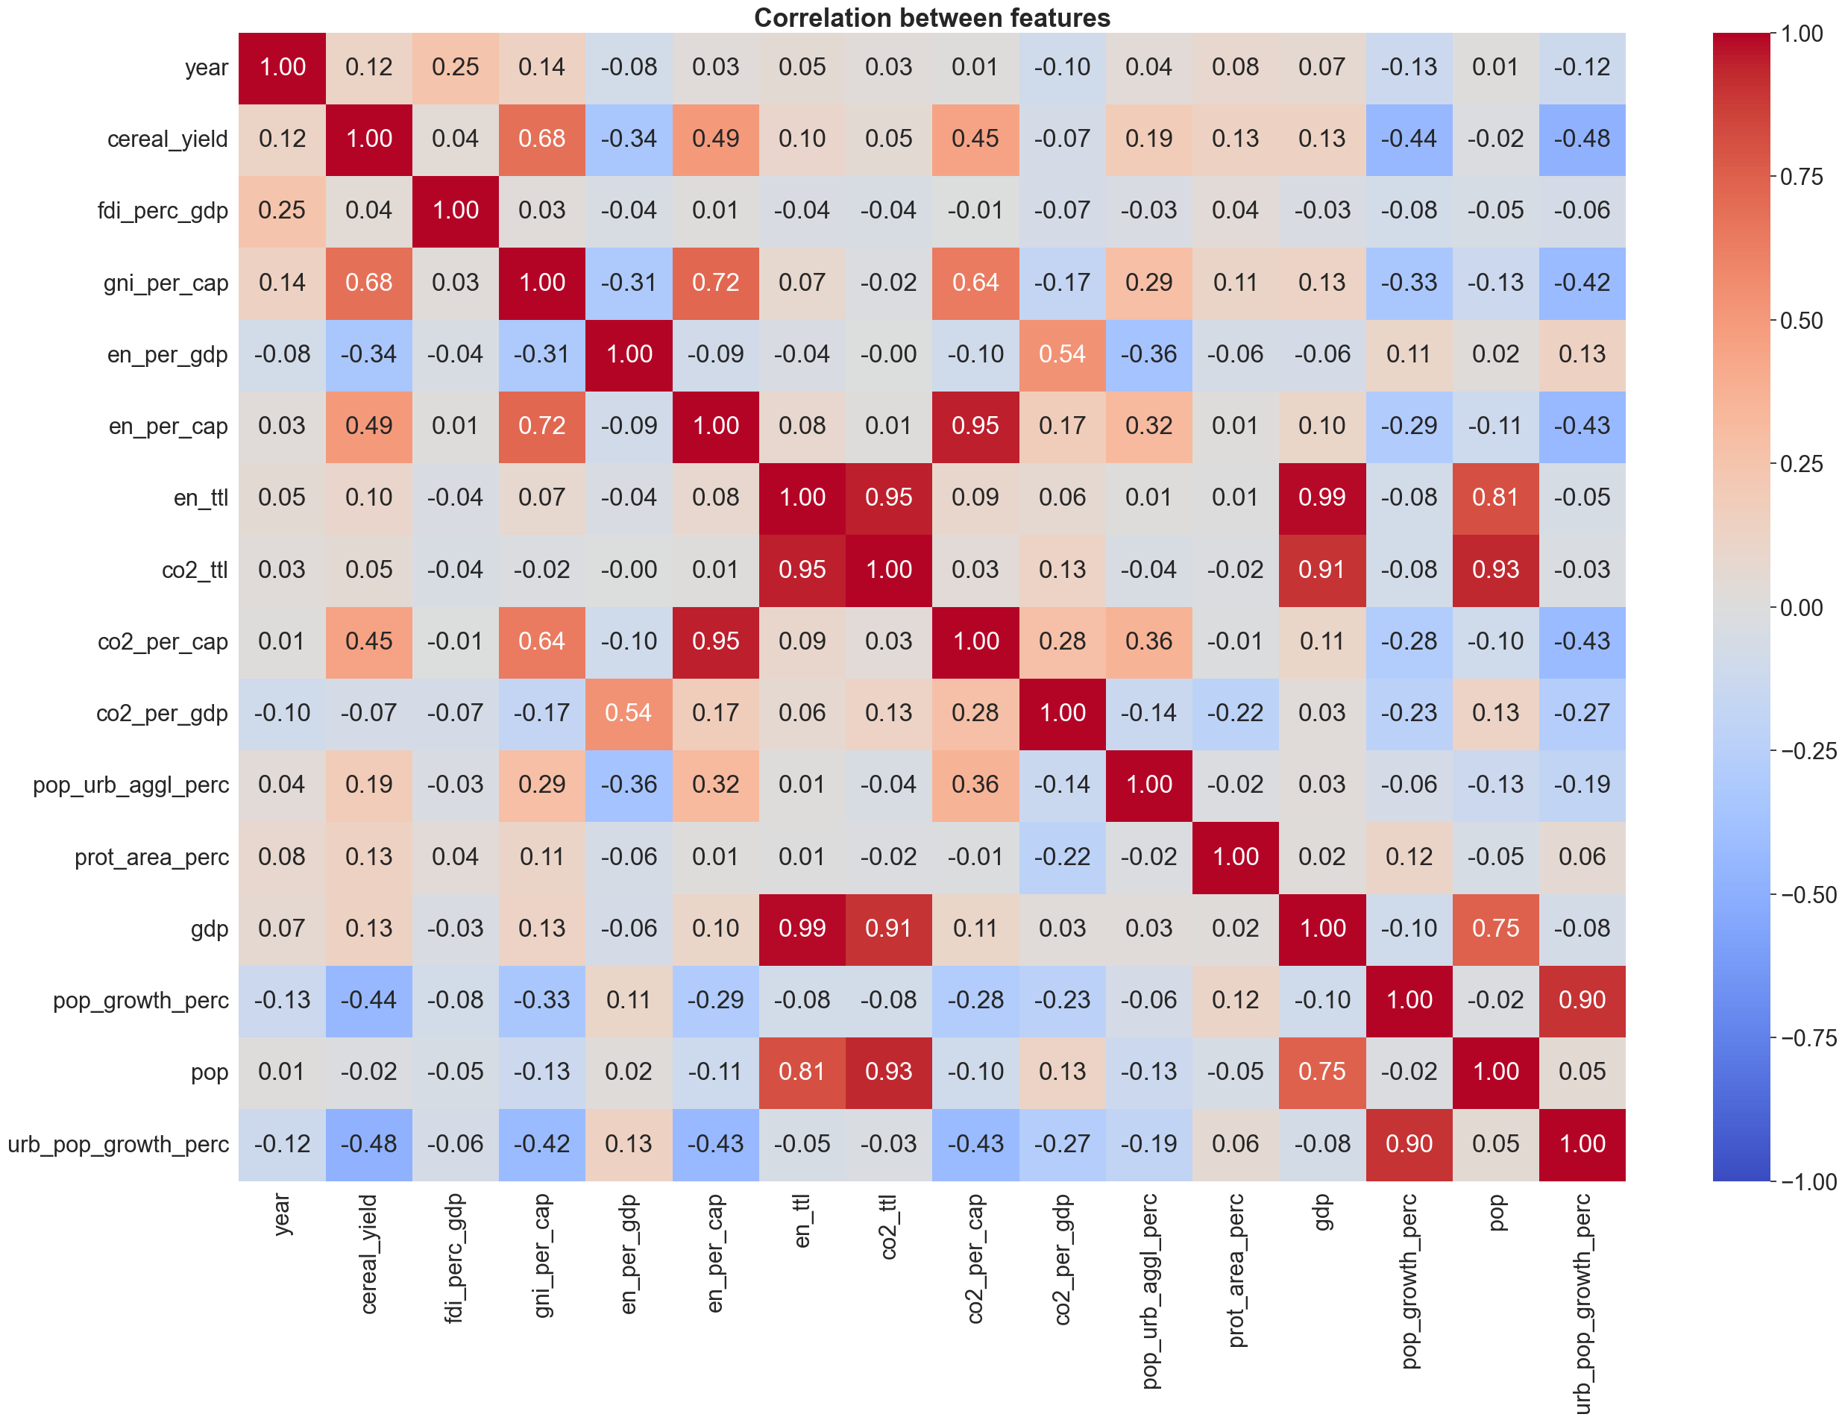
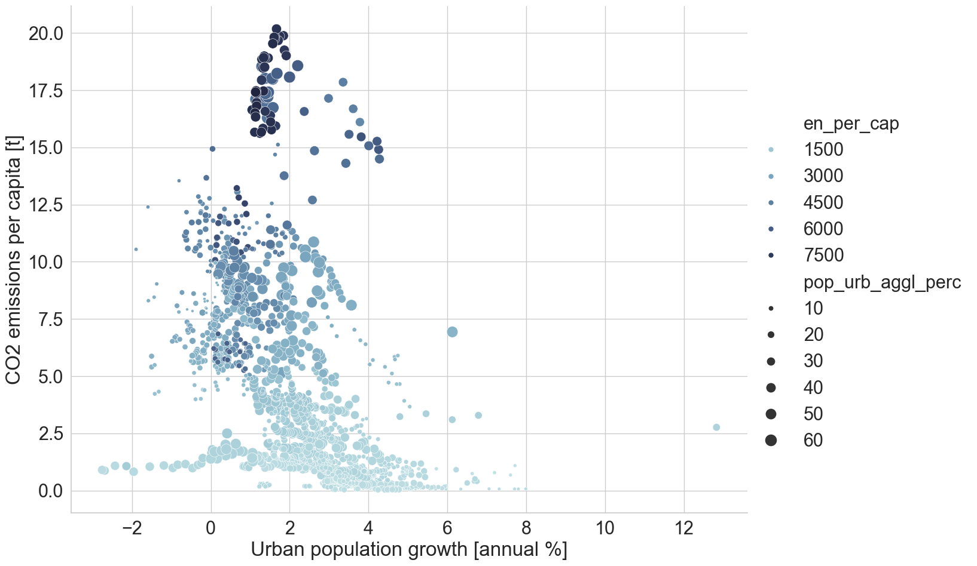
Choosing the Best Unit for CO₂ Emissions & Energy Use

Slide 9
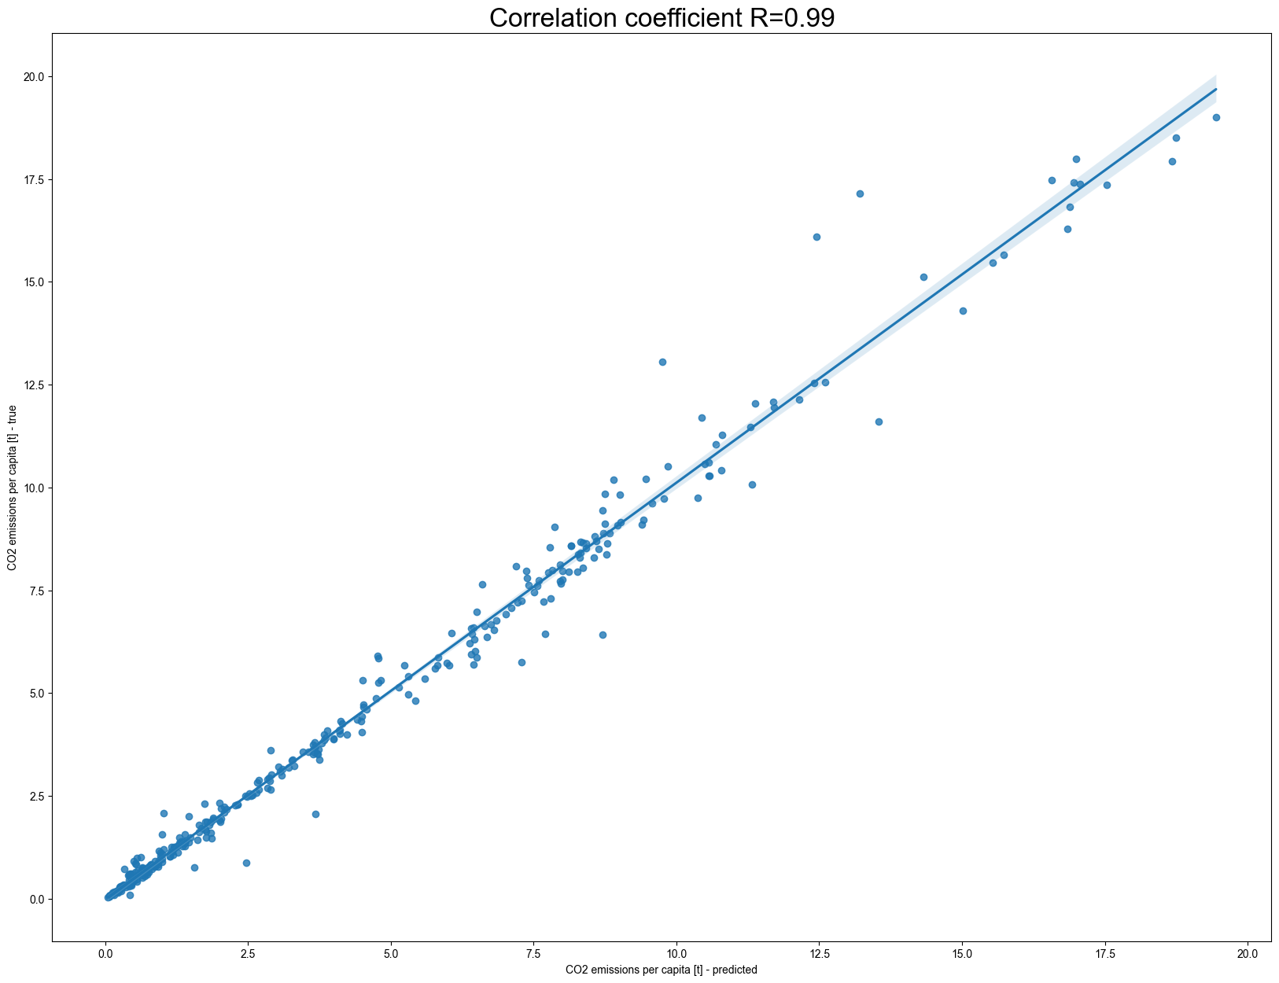
Model Evaluation & Prediction Quality

Slide 10
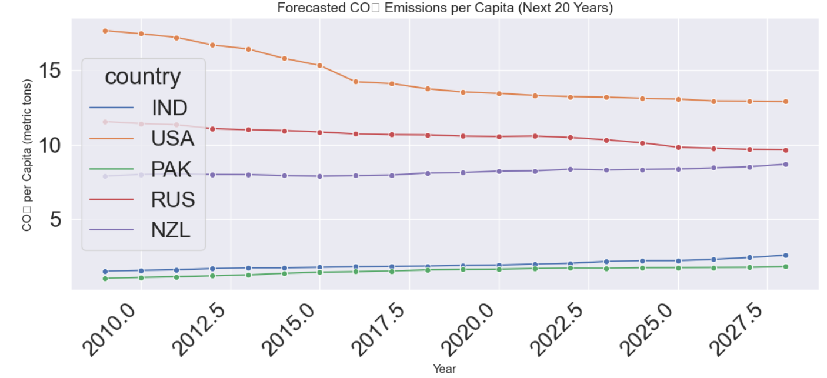
📈 Forecasted CO₂ Emissions per Capita (Next 20 Years)

Slide 11
.
Conclusion:
🔚 Project Summary:
We successfully developed a machine learning pipeline to analyze and predict CO₂ emissions using historical, country-specific data.
📈 Technical Highlights:
• Cleaned and merged multi-dimensional datasets (1990–2011)
• Conducted in-depth data visualization and feature engineering
• Trained and compared regression models: Linear, XGBoost, Random Forest
• Achieved high accuracy with Random Forest Regressor (best R² score)
🌍 Insights:
• Key predictors of CO₂ emissions: GDP, energy usage, and urbanization
• Forest area shows a negative correlation with emissions
• ML-based forecasting can assist governments in climate decision-making
🚀 Future Scope:
• Integrate real-time global datasets via APIs
• Deploy interactive dashboards with Streamlit
• Extend to time-series forecasting (ARIMA, Prophet)

